Slide 1
Modified Phase Frequency Detector (PFD) Analysis in 32nm node
Ali Attaran
Professor Dr. Hao Jiang
Nov 2016

Slide 2

Outline
Introduction
What does PFD do? Why PFD is crucial in PLL
Background
Traditional DFF PFD
Modified PFD
Implementation
Performance comparison between Traditional DFF PFD and Modified PFD
Conclusion

Slide 3
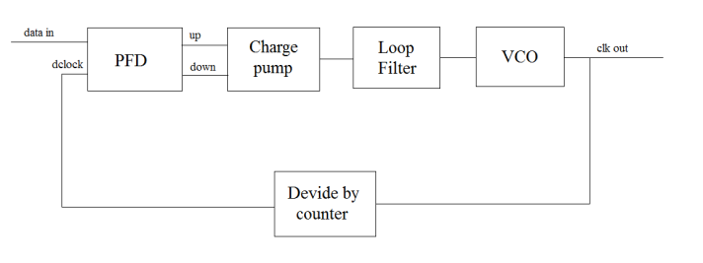
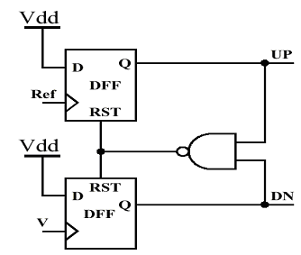
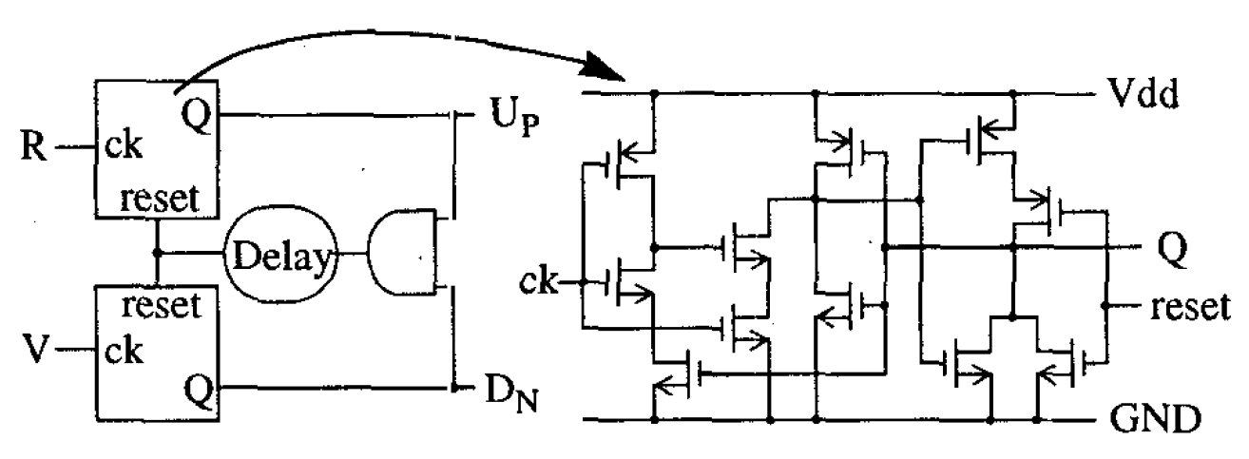
Introduction
What it does?
Requirement:
High sensitivity
Moderate frequency of operation
Challenges:
Linearity of PFD
Gain of PFD
Qa
a
Qb
Modified PFD
b
Traditional PFD
[B. H. Park, P. E. Allen, IEEE, 1998]

Slide 4
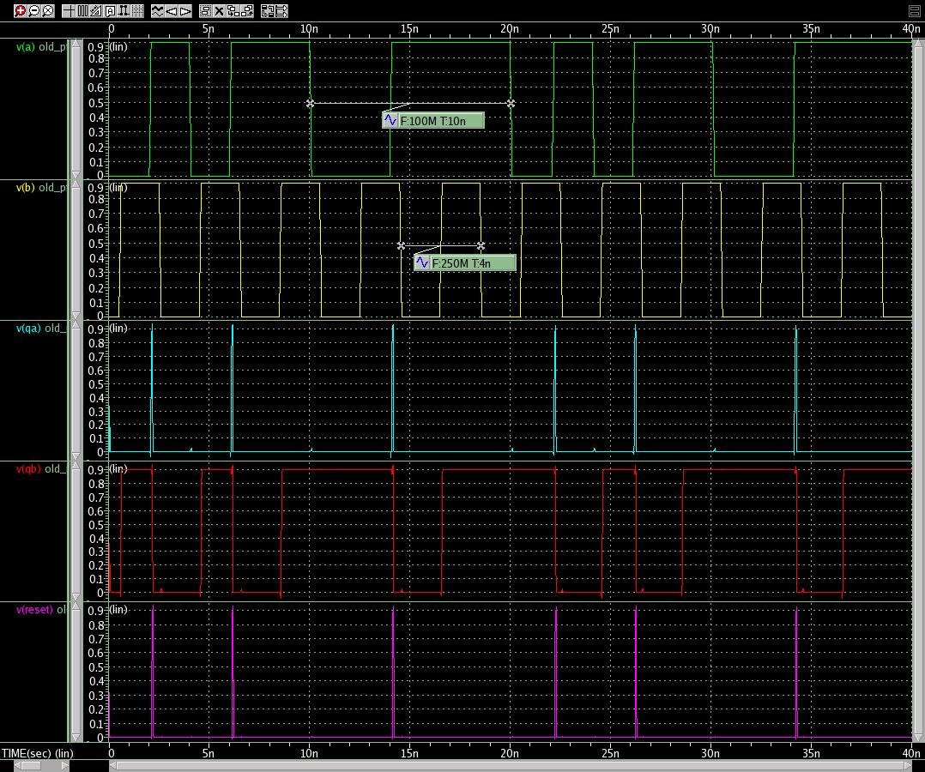
Traditional PFD
Qa
A
a
B
Qb
Qa
b
Qb
A
Reset
B
Modulated Inputs frequencies : Qb gets high when phase(b) is leading phase(a)

Slide 5
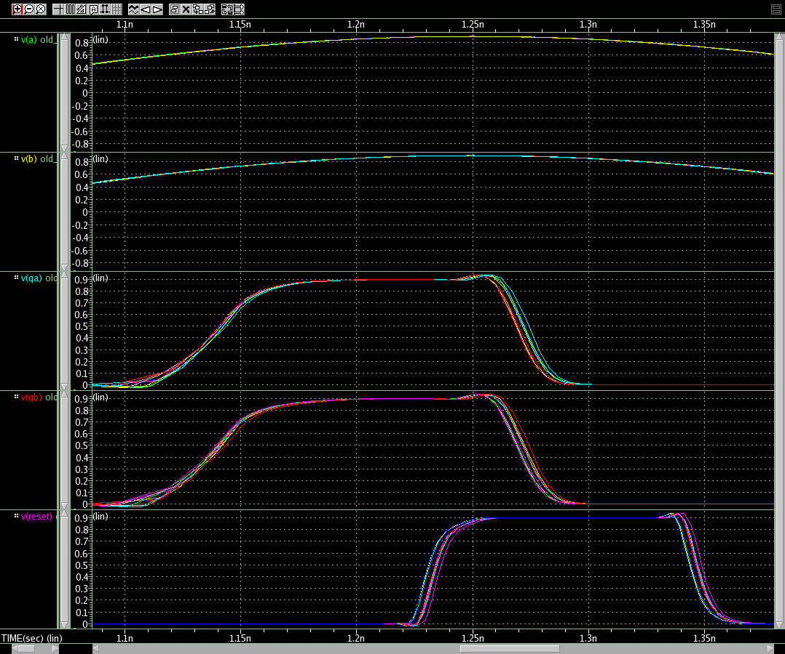
Traditional PFD
Measure sensitivity to phase difference with Monte Carlo simulation
Qa
a
A
Qb
b
B
Qa
Qa
Qb
Qb
With additional delay deadzone will improve
Reset
Reset

Slide 6
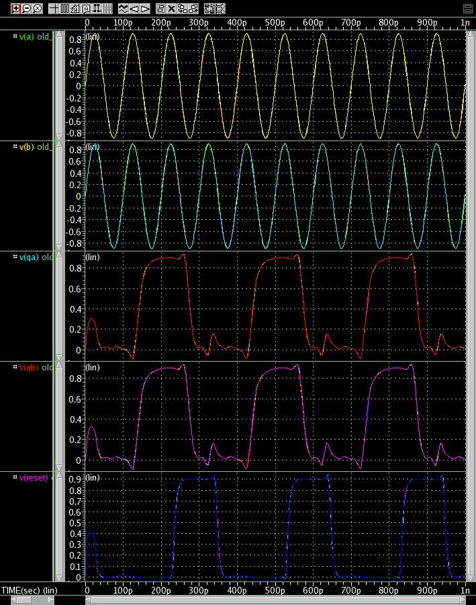
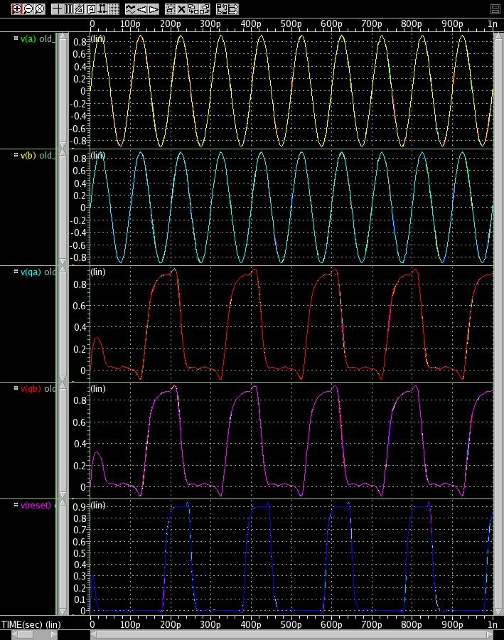
Traditional PFD
The speed of the circuit is limited
The circuit cannot operate at high frequency
Qa
a
Qb
A
b
B
A
Detecting 2nd harmonic
Improved at lower frequency
Qa
B
Qa
Qb
Qb
Reset
Reset

Slide 7
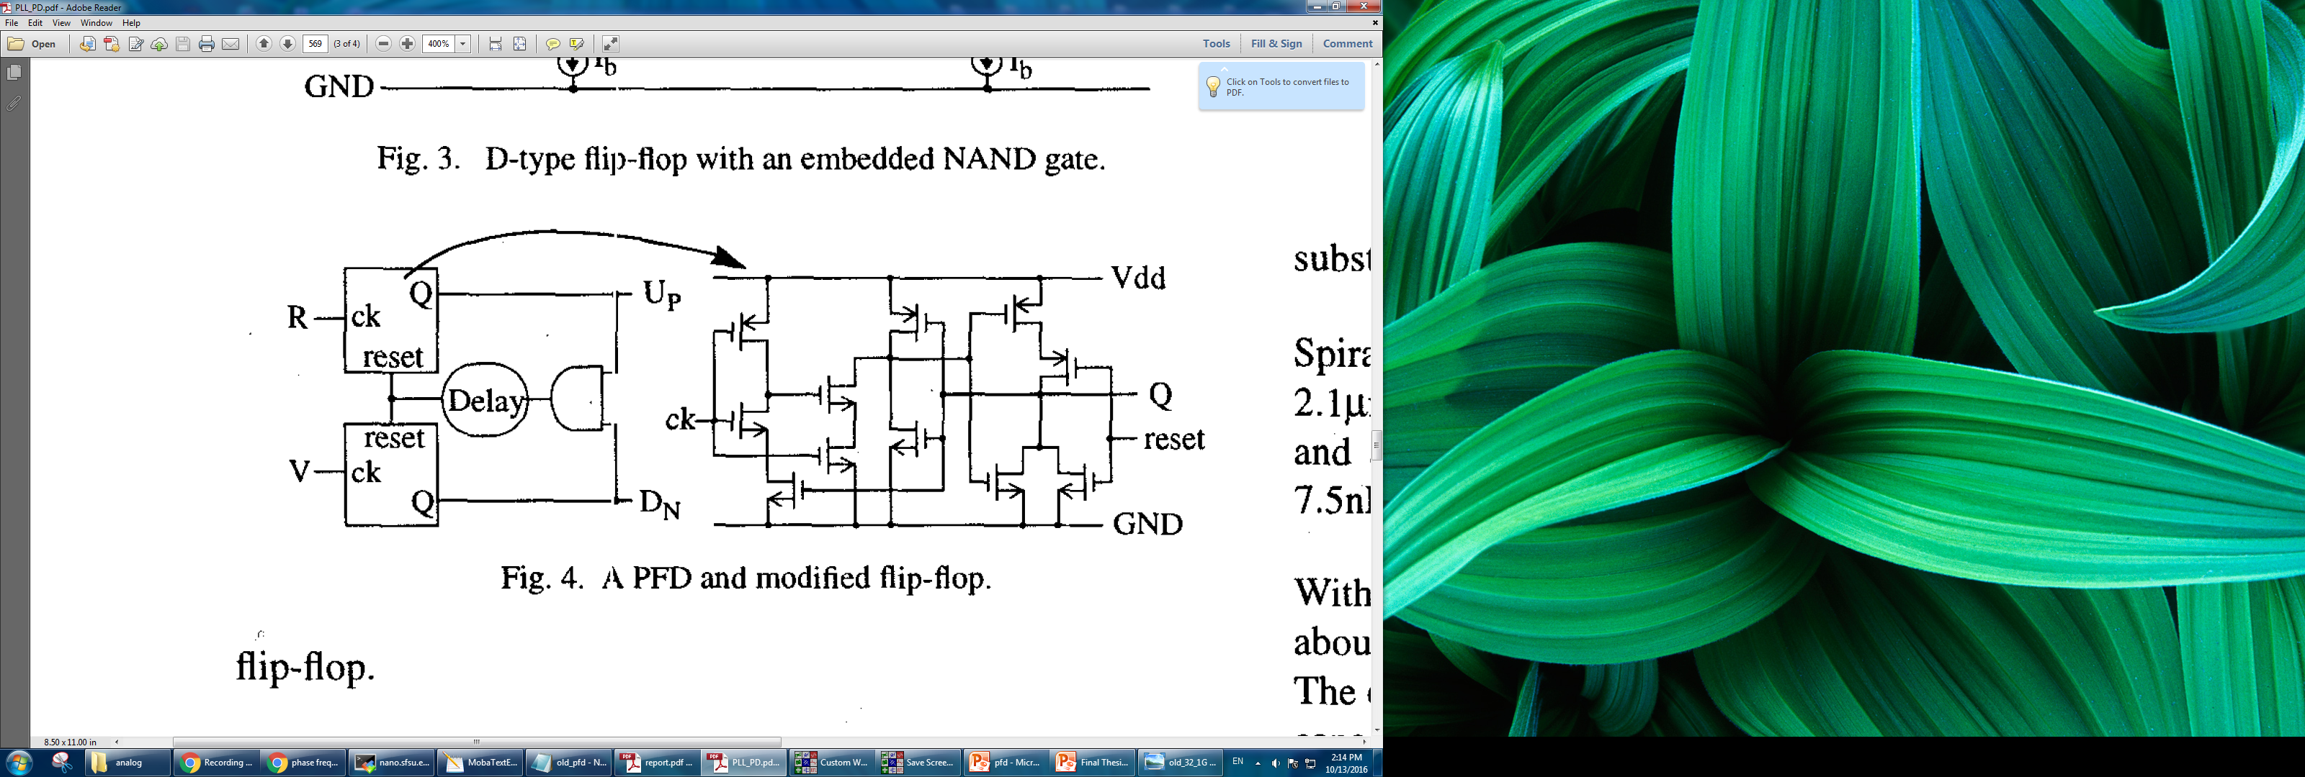
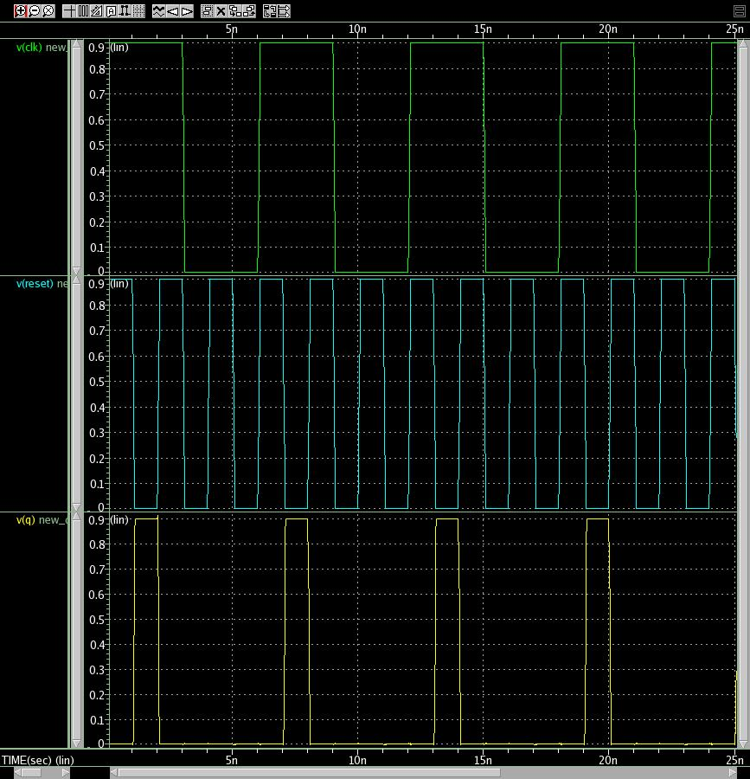
Modified PFD
The deadZone is improved in the modified PFD because of the additional delays.
CLK
Reset
Q
x2
x2
x1
x2
[B. H. Park, P. E. Allen, IEEE, 1998]

Slide 8
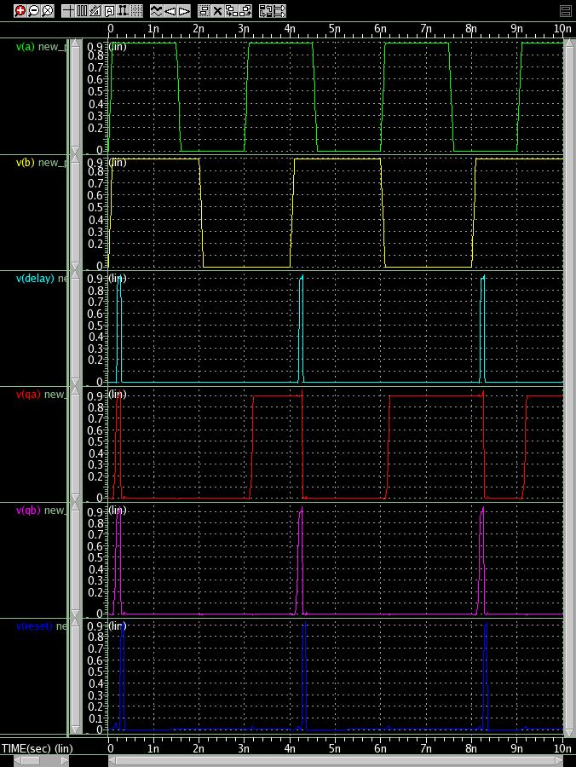
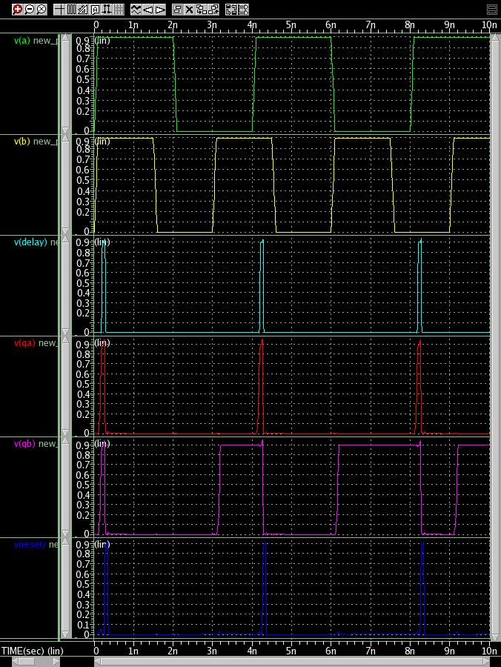
Modified PFD
R frequency > V frequency
R
V
V frequency > R frequency
Delay
Up
Dn
Reset

Slide 9
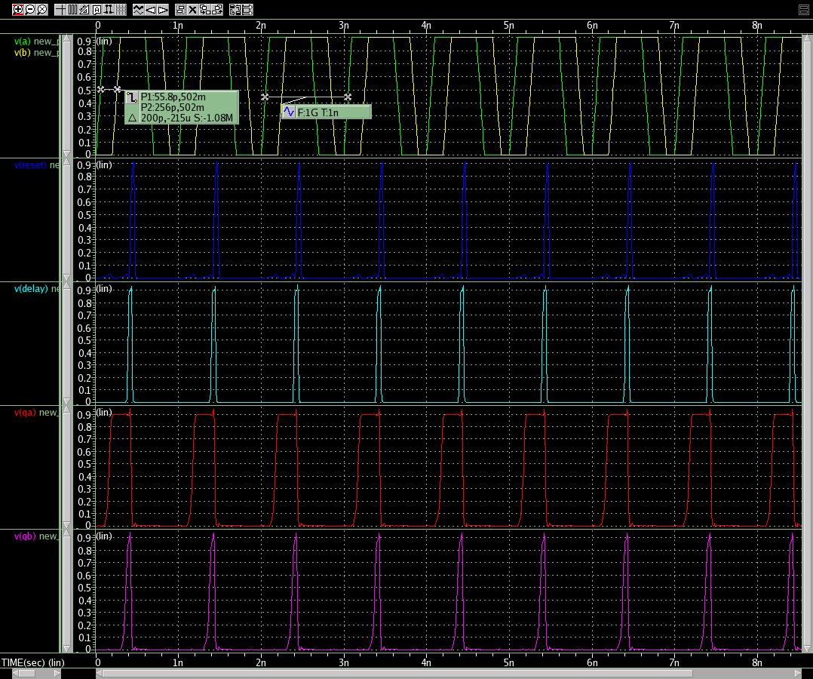
Modified PFD
Input Frequencies have 0.5ns difference which leads to one input has phase difference
R,
V
Reset
Delay
Up
Dn
x2
x2
x1
x2

Slide 10
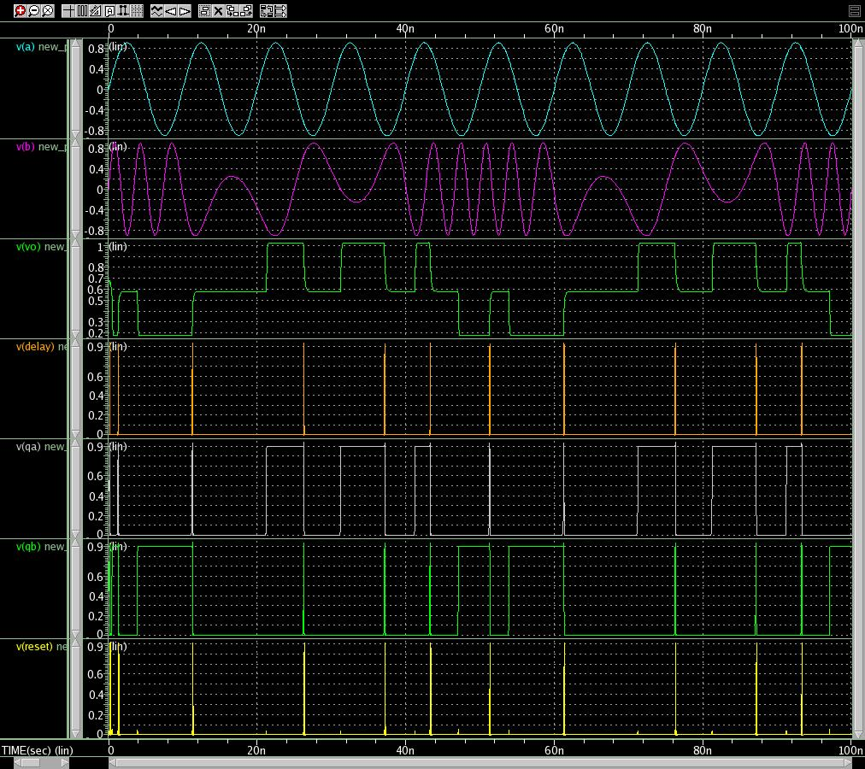
Modified PFD
Modulated Input Frequency:100MHz&20MHz and 100MHz
R
V
Vo
Delay
Up
Dn
Reset

Slide 11
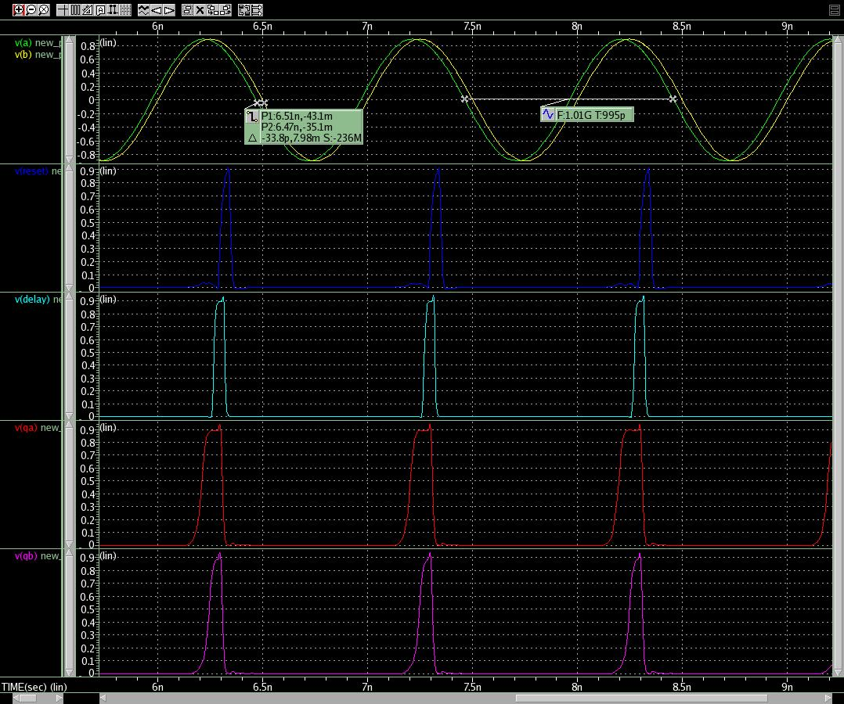
Modified PFD
Detecting phase difference
R, V
Delay
Up
Dn
Reset

Slide 12
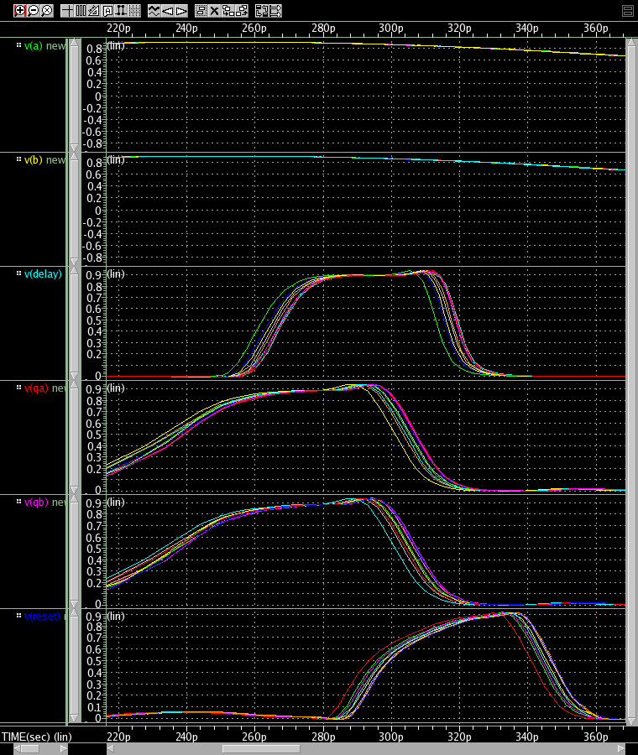
Modified PFD
Measure sensitivity to phase difference with Monte Carlo simulation
R
V
Delay
Up
Dn
Sensitivity to phase difference
Reset

Slide 13
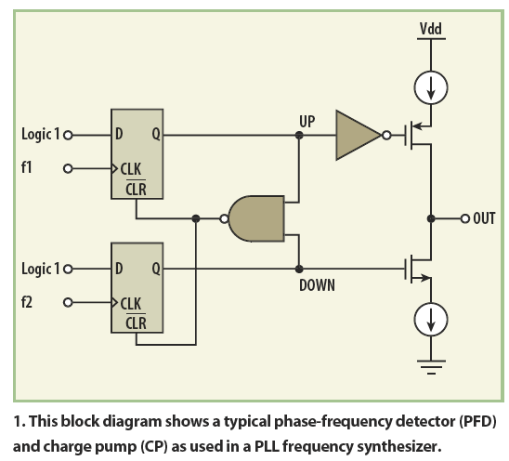
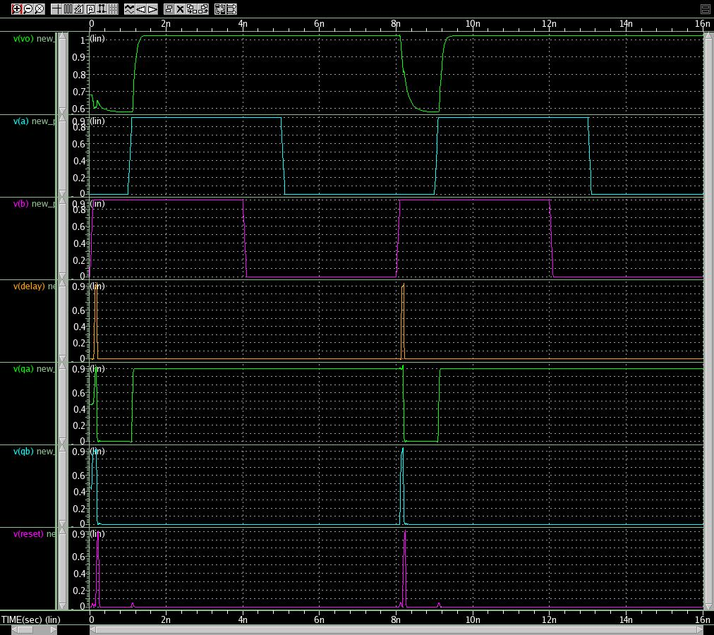
Modified PFD + Charge Pump
Input A has -1ns delay compared to B
Current source: 1mA
R
Vout
V
A
B
Delay
Delay
Up
[Jeffrey S. Pattavina, mwrf, 2011]
QA
Dn
QB
Sensitivity to phase difference
Reset
Reset

Slide 14
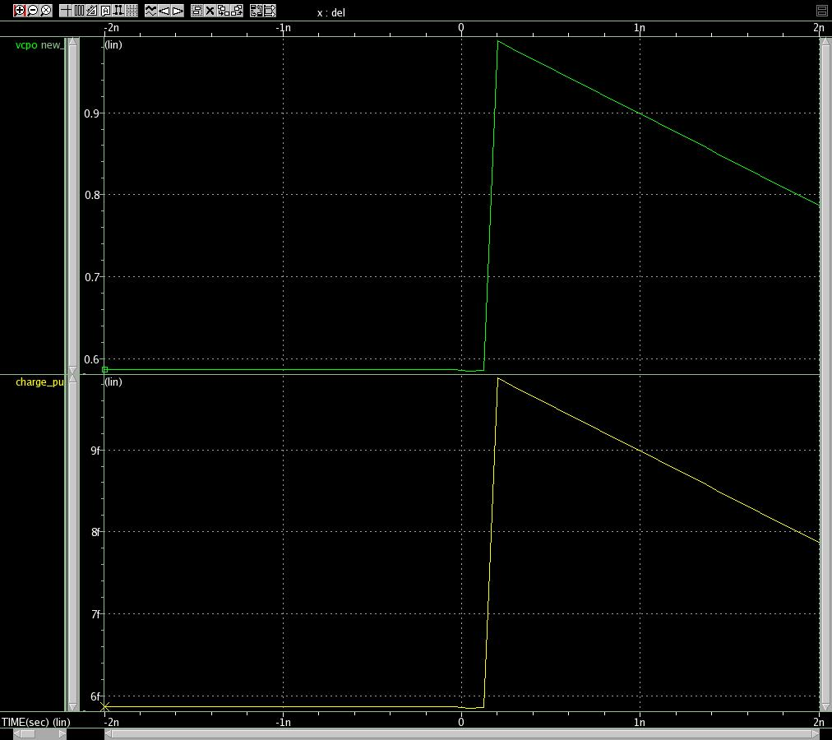
Modified PFD + Charge Pump
Monte Carlo simulation with A input delay varies from -1n to +1n.
From -1n to 0ns delay: Vout is low, Cout is discharged.
From 0ns to +1ns delay, Vout is high, Cout is charged.
R
V
Vout
Delay
Up
[Jeffrey S. Pattavina, mwrf, 2011]
Dn
Cout
Sensitivity to phase difference
Reset

Slide 15
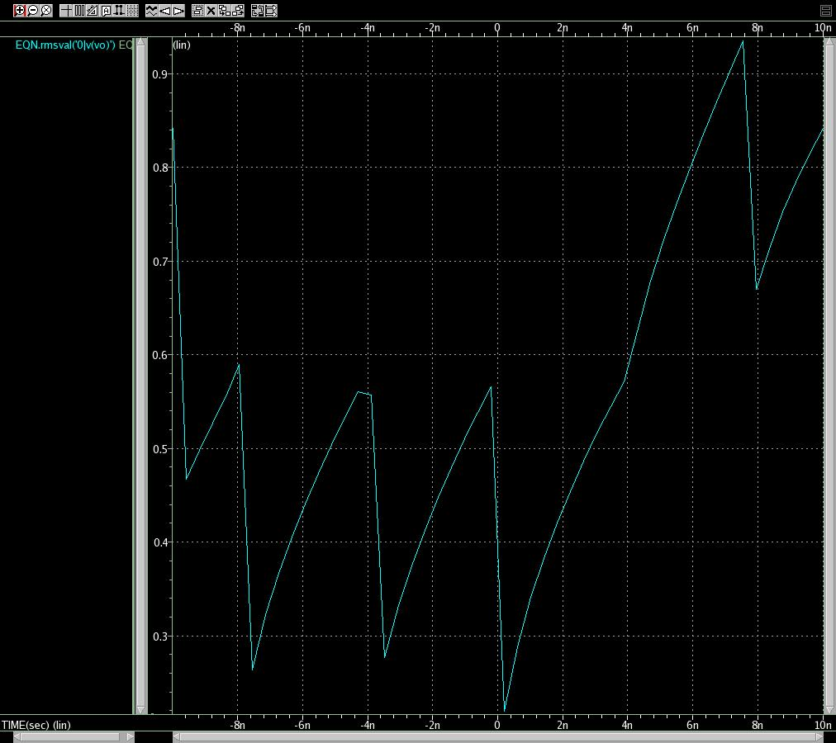
Modified PFD + Charge Pump
Monte Carlo simulation with A input delay varies from -10n to +10n.
B input period 2ns
R
V
Vout
Delay
RMS(Vout)
2ns
Up
[Jeffrey S. Pattavina, mwrf, 2011]
Dn
Cout
Zero phase difference
Reset
Delay

Slide 16
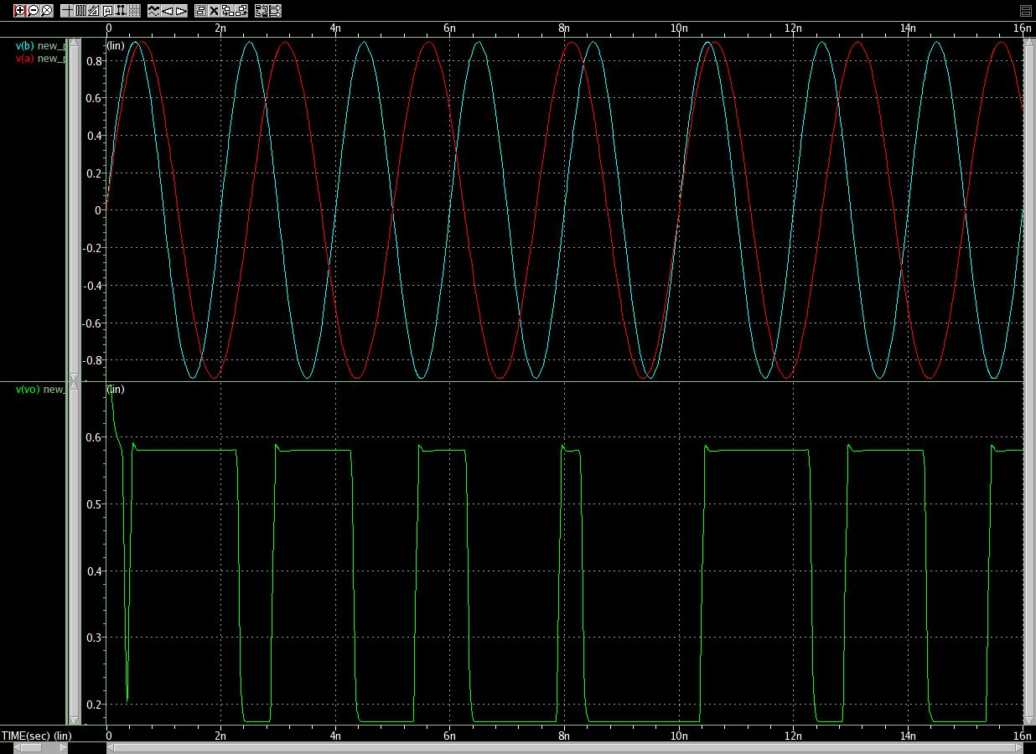
Modified PFD + Charge Pump
Detecting frequency difference
Current source: 1mA
R
Vout
V
Freq(A)
Freq(B)
A
B
Delay
Delay
Up
[Jeffrey S. Pattavina, mwrf, 2011]
QA
Dn
Vout
QB
Sensitivity to phase difference
Reset
Reset

Slide 17
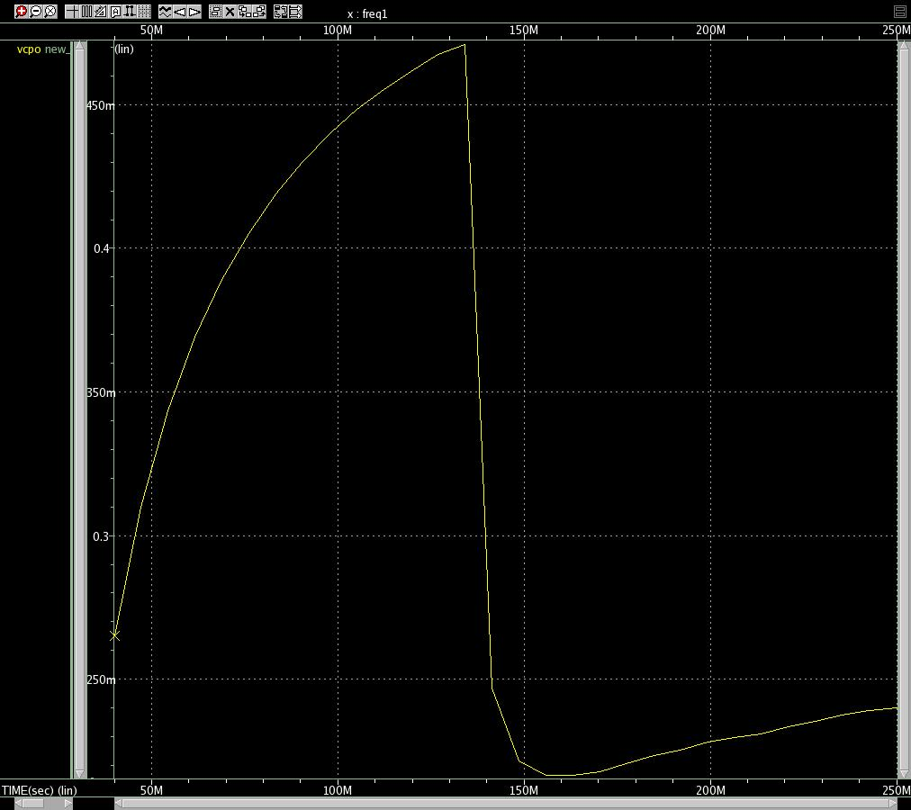
Modified PFD + Charge Pump
Input A Frequency from 40MHz to 240MHz
Input B: 100MHz
RMS(Vout)
[Jeffrey S. Pattavina, mwrf, 2011]
Frequency
Sensitivity to phase difference

Slide 18
Conclusion
The phase difference is more linear, more sensitive to phase difference
the Modified PFD is not restricted with clock speed as much as traditional PFD
Higher frequency of operation

Slide 19
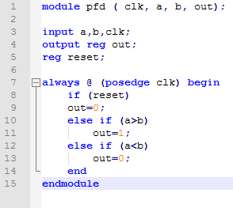
Synthesized PFD
Write the behavioral code of PFD in Verilog
Verify with simulations
Generate Gate-level netlist in DC Shell
Connect it to the 32nm Library files
Simulation

Slide 20
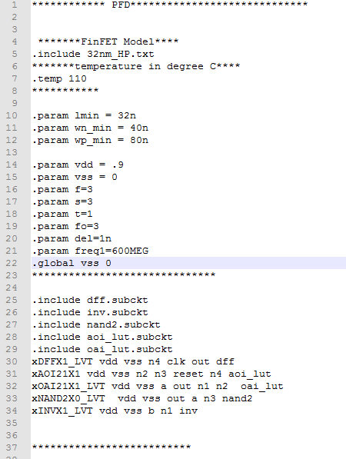
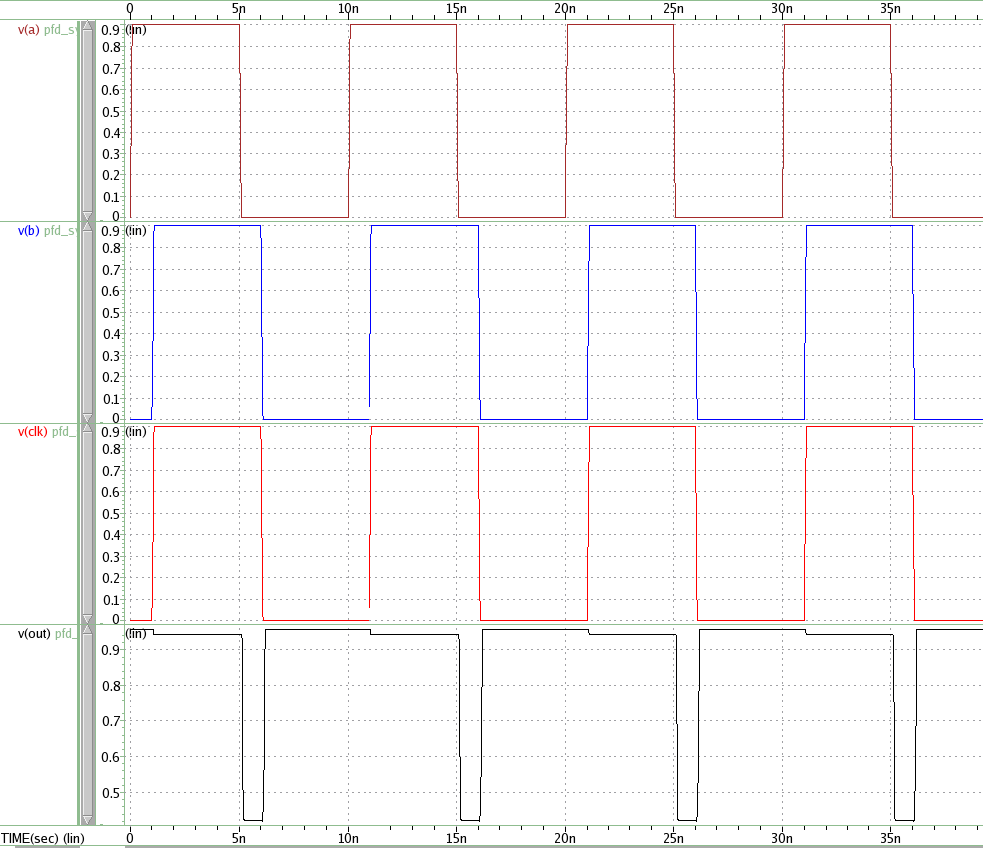
Synthesized PFD
Write the behavioral code of PFD in Verilog
Verify with simulations
Generate Gate-level netlist in DC Shell
Connect it to the 32nm Library files
Simulation

Slide 21
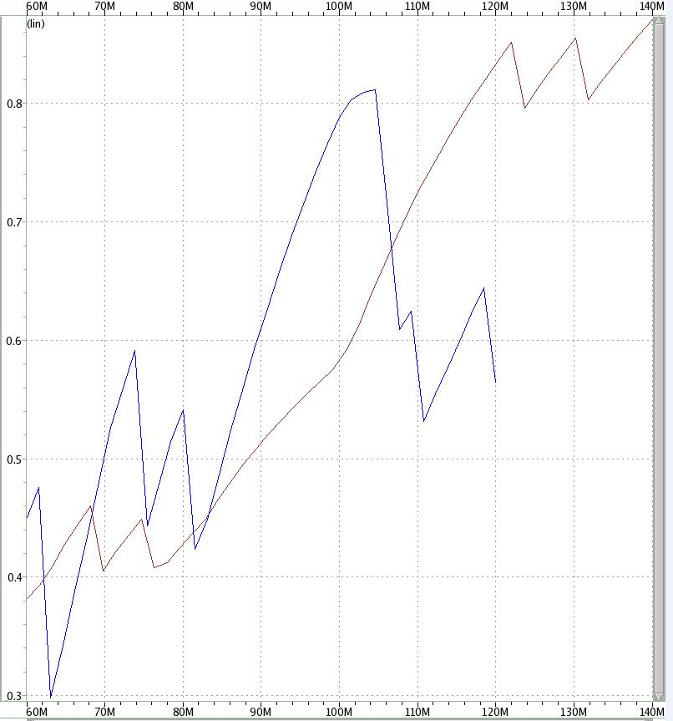
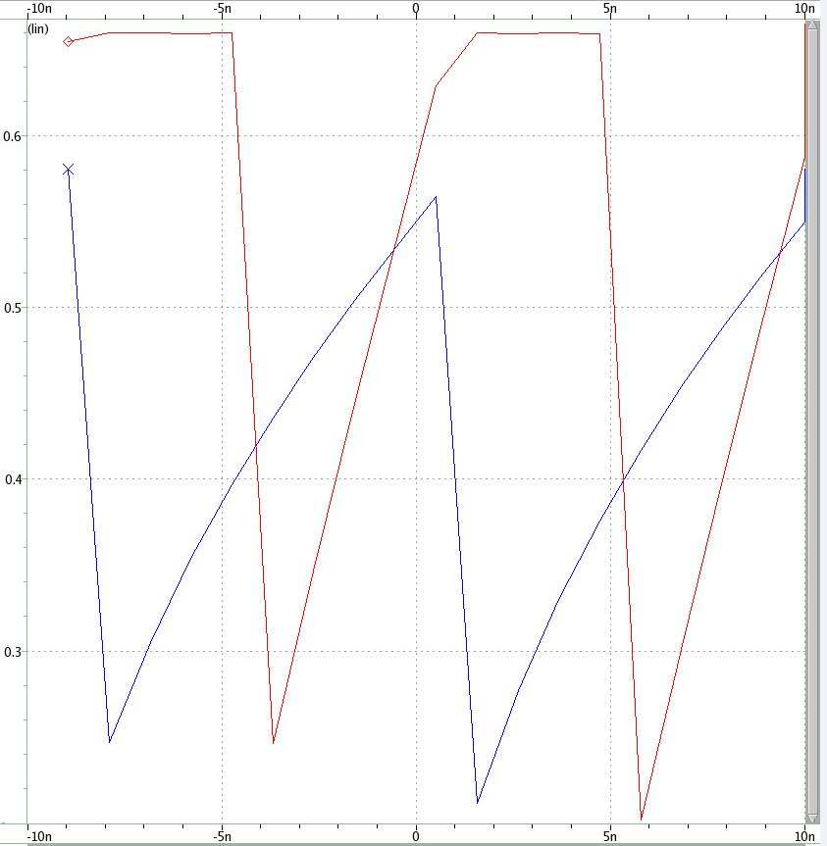
Synthesized PFD and modified PFD comparison
Sweep the frequency of one of the inputs from 80MHz to 120MHz, the other input frequency at 100MHz
Sweep the delay of one of the inputs from -5ns to +5ns, the other input at 0 delay at 100MHz
Modified PFD
Modified PFD
Synthesized PFD
40MHz
Synthesized PFD
23MHz

Slide 22
Conclusion
Modified PFD performs better in terms of bandwidth, linearity and output peak-to-peak value, but burns more power.
Synthesized PDF has much lower switching and leakage power; and area but has poor linearity ratio and operating bandwidth. It has better power because the synthesizer optimizes the design in terms of power and area optimization as long the design satisfies the design constraints; like slack time in timing analysis, pulse there are a lot of optimization commands are applied to minimize the power and area.
 | Switching power (nW) | Leakage power (nW) | peak-to-peak output (V) | Offset output voltage (V) | Bandwidth (Hz) | Area | Linearity (dv/dphi)
Modified PFD | 1545.7e3 | 329e3 | 0.46 ~vdd/2 | ~0.4 | 40MHz | 3040 | 0.84
Synthesized PFD | 3.7227 | 4464.1 | 0.4 | ~0.3 | 23MHz | 2400 | 0.0173

